Slide 1

Chapter 7
Run-Time Environments

Slide 2
Outline
Compiler must do the storage allocation and provide access to variables and data
Memory management
  Stack allocation
  Heap management
  Garbage collection

Slide 3
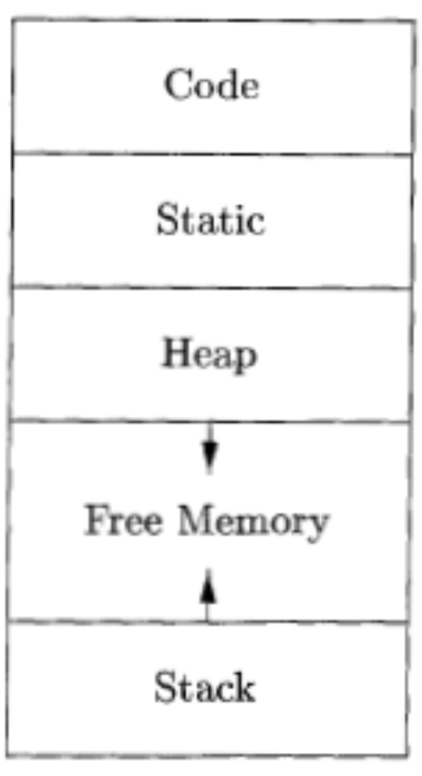
Storage Organization

Slide 4
Static vs. Dynamic Allocation
Static: Compile time, Dynamic: Runtime allocation
Many compilers use some combination of following
  Stack storage: for local variables, parameters and so on
  Heap storage: Data that may outlive the call to the procedure that created it
Stack allocation is a valid allocation for procedures since procedure calls are nested

Slide 5
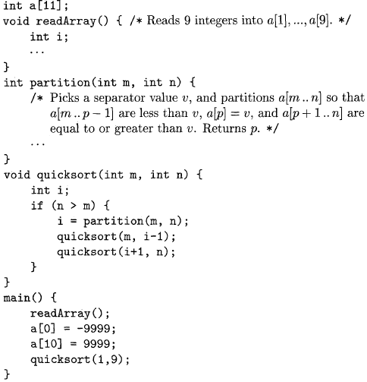
Sketch of a quicksort program

Slide 6
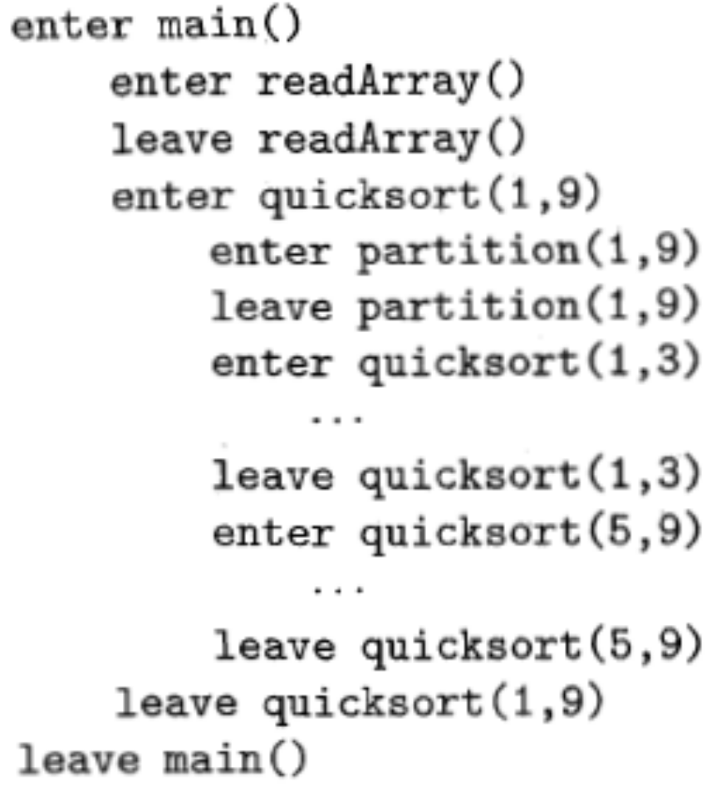
Activation for Quicksort

Slide 7
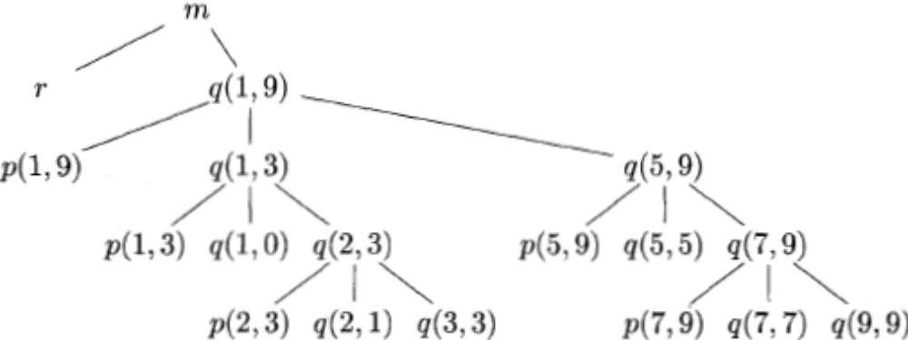
Activation tree representing calls during an execution of quicksort

Slide 8
Activation records
Procedure calls and returns are usaully managed by a run-time stack called the control stack.
Each live activation has an activation record (sometimes called a frame)
The root of activation tree is at the bottom of the stack
The current execution path specifies the content of the stack with the last activation has record in the top of the stack.

Slide 9
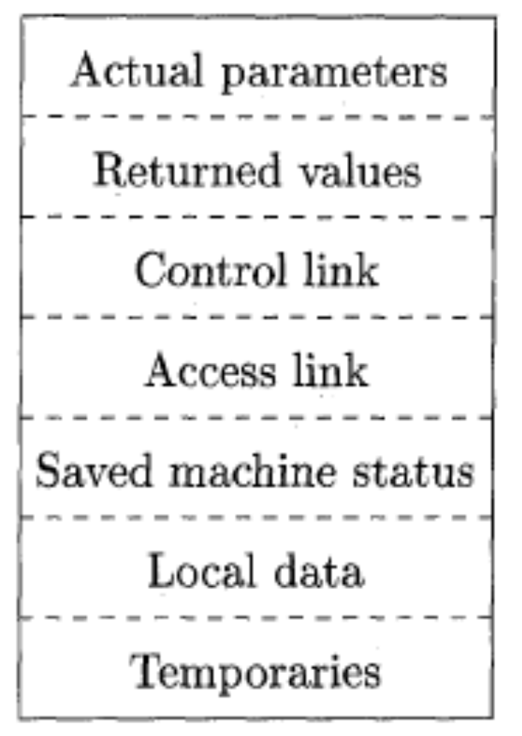
A General Activation Record

Slide 10
Activation Record
Temporary values
Local data
A saved machine status
An “access link”
A control link
Space for the return value of the called function
The actual parameters used by the calling procedure

Slide 11
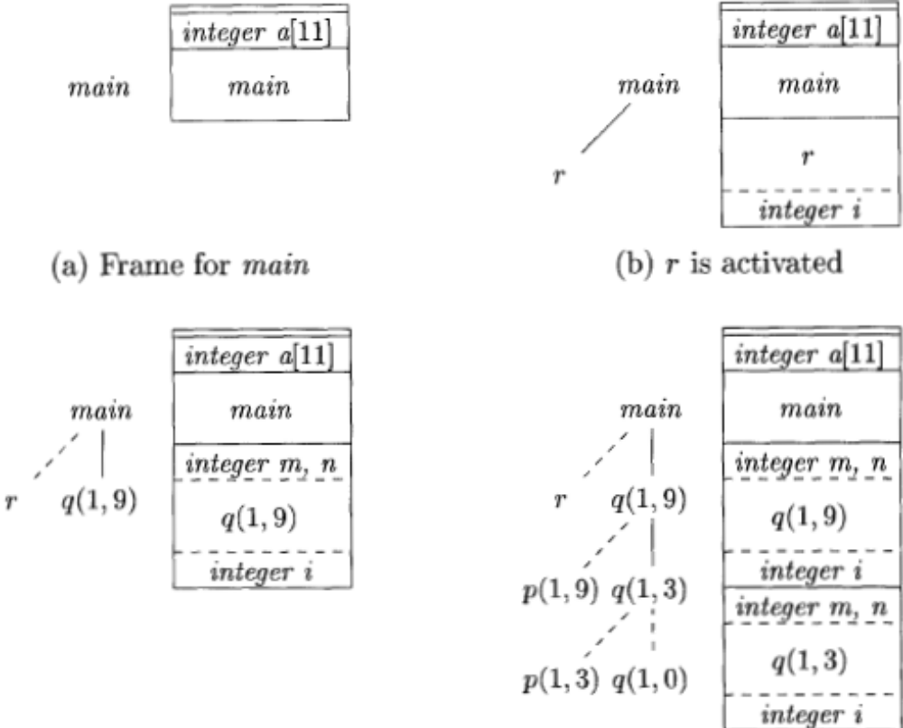
Downward-growing stack of activation records

Slide 12
Designing Calling Sequences
Values communicated between caller and callee are generally placed at the beginning of callee’s activation record
Fixed-length items: are generally placed at the middle
Items whose size may not be known early enough: are placed at the end of activation record
We must locate the top-of-stack pointer judiciously: a common approach is to have it point to the end of fixed length fields.

Slide 13
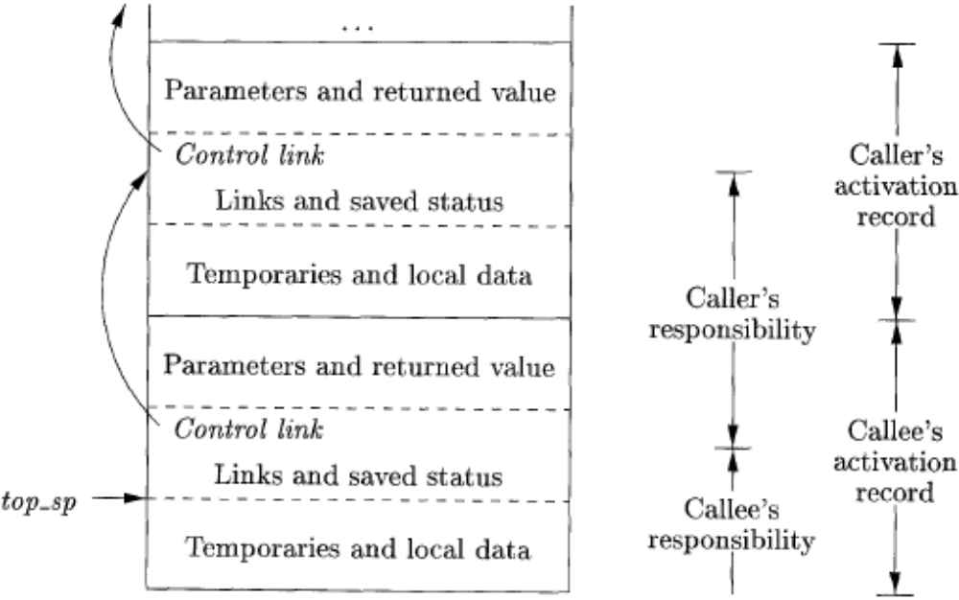
Division of tasks between caller and callee

Slide 14
calling sequence
The caller evaluates the actual parameters
The caller stores a return address and the old value of top-sp into the callee's activation record.
The callee saves the register values and other status information.
The callee initializes its local data and begins execution.

Slide 15
corresponding return sequence
The callee places the return value next to the parameters
Using information in the machine-status field, the callee restores top-sp and other registers, and then branches to the return address that the caller placed in the status field.
Although top-sp has been decremented, the caller knows where the return value is, relative to the current value of top-sp; the caller therefore may use that value.

Slide 16
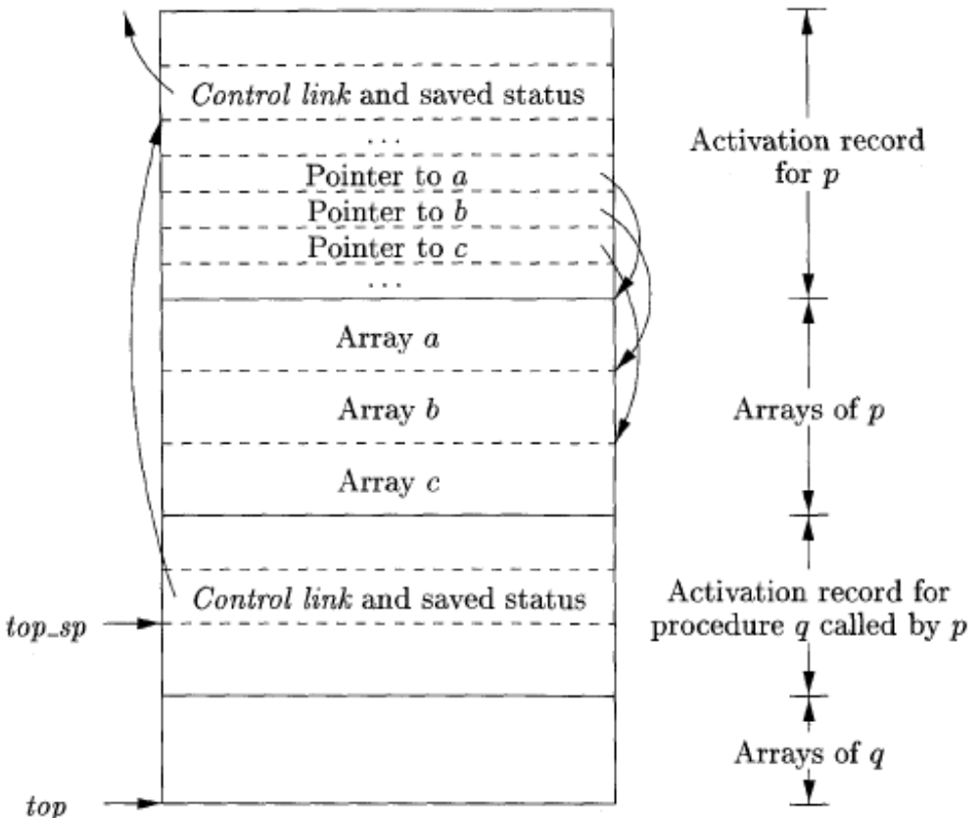
Access to dynamically allocated arrays

Slide 17
ML
ML is a functional language
Variables are defined, and have their unchangeable values initialized, by a statement of the form:
        val (name) = (expression)
Functions are defined using the syntax:
        fun (name) ( (arguments) ) = (body)
For function bodies we shall use let-statements of the form:
        let (list of definitions) in (statements) end

Slide 18
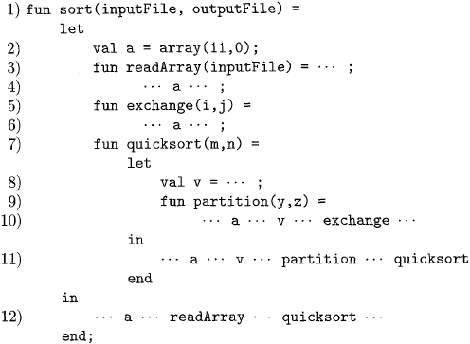
A version of quicksort, in ML style, using nested functions

Slide 19
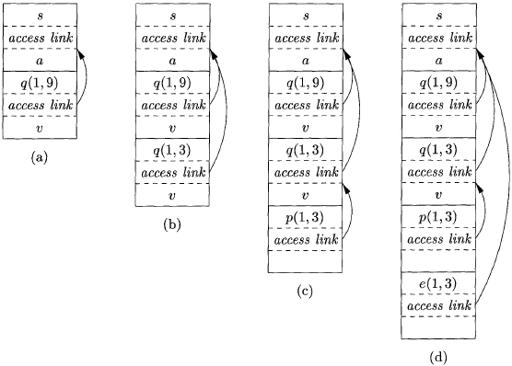
Access links for finding nonlocal data

Slide 20
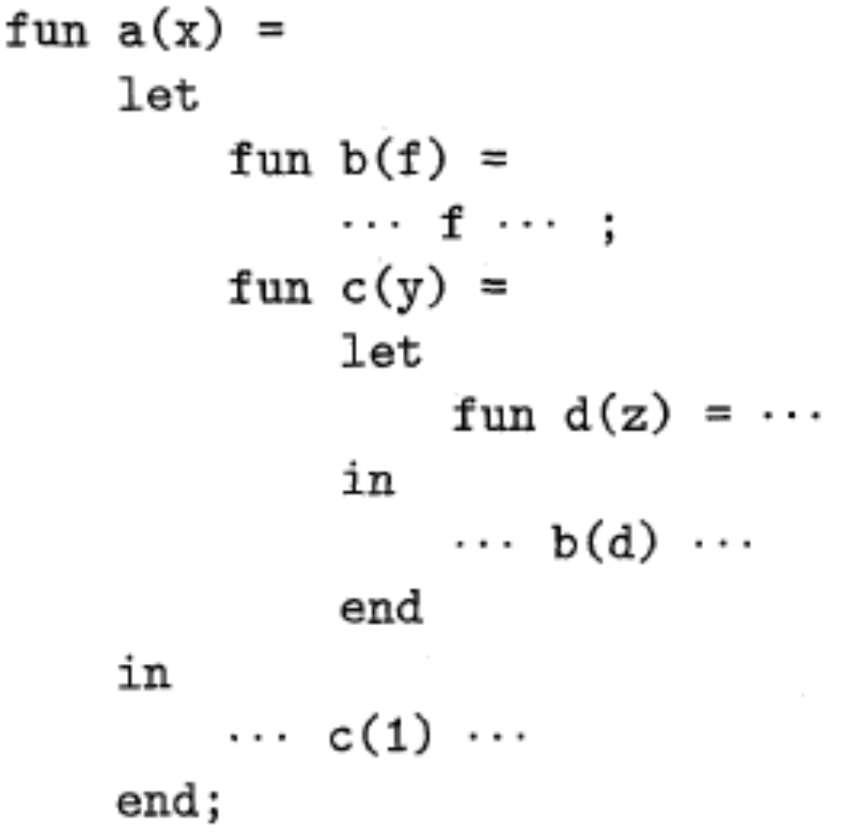
Sketch of ML program that uses function-parameters

Slide 21
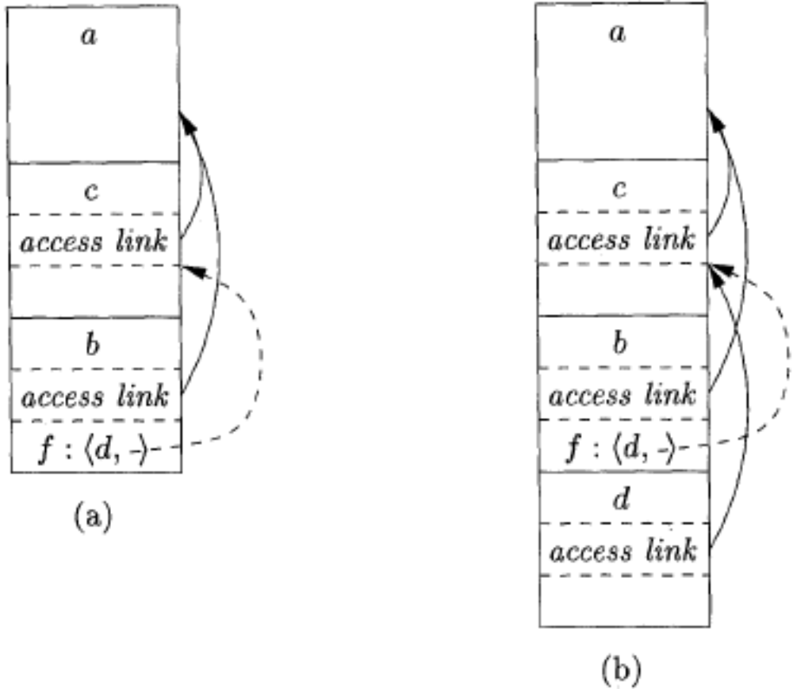
Actual parameters carry their access link with them

Slide 22
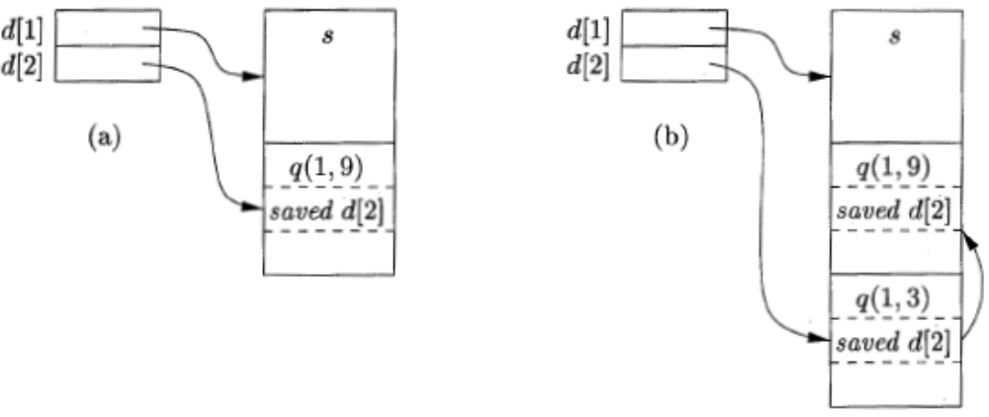
Maintaining the Display

Slide 23
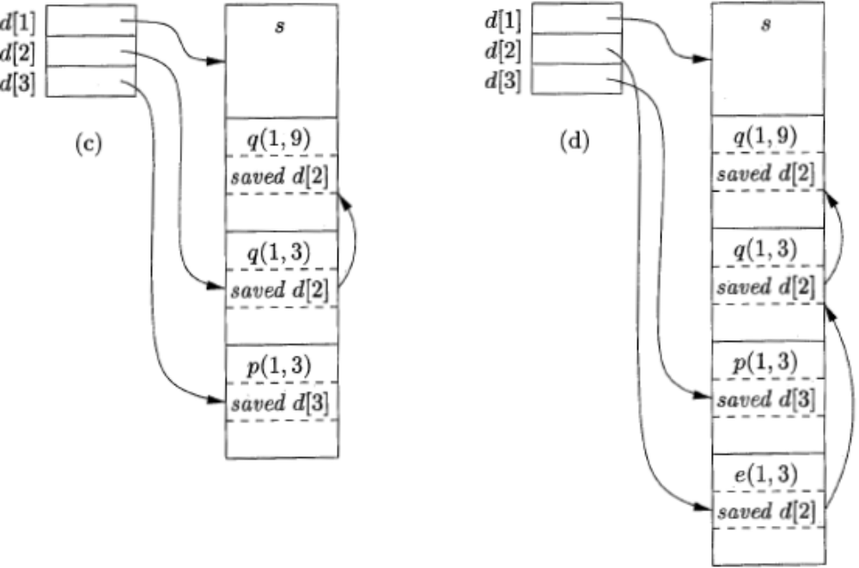
Maintaining the Display (Cont.)

Slide 24
Memory Manager
Two basic functions:
  Allocation
  Deallocation
Properties of memory managers:
  Space efficiency
  Program efficiency
  Low overhead

Slide 25
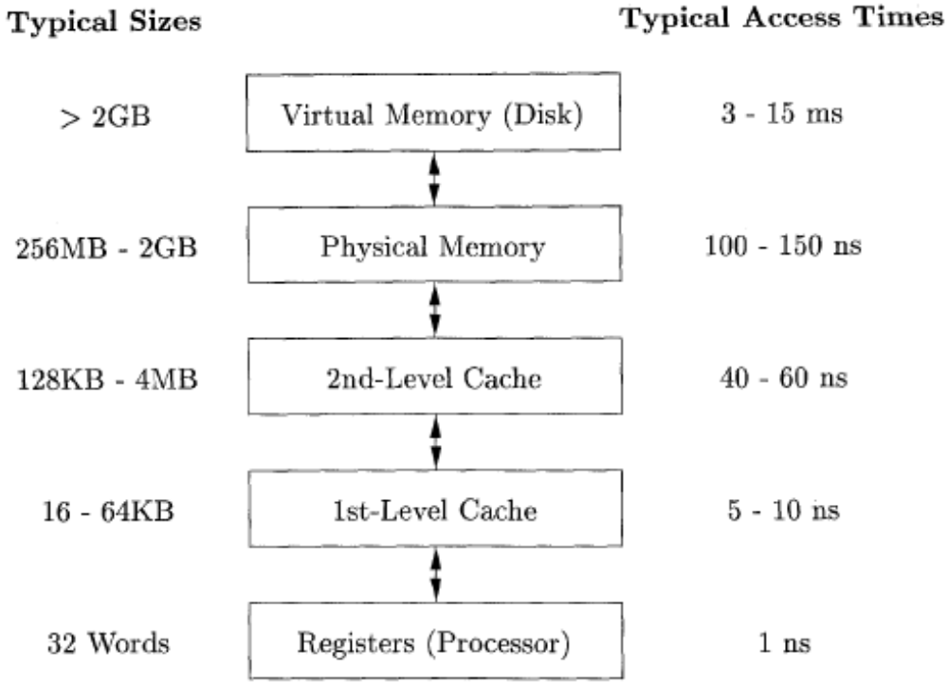
Typical Memory Hierarchy Configurations

Slide 26
Locality in Programs
The conventional wisdom is that programs spend 90% of their time executing 10% of the code:
Programs often contain many instructions that are never executed.
Only a small fraction of the code that could be invoked is actually executed in a typical run of the program.
The typical program spends most of its time executing innermost loops and tight recursive cycles in a program.

Slide 27
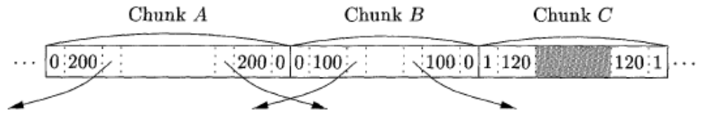
Part of a Heap

Slide 28

Reference Counting
Mark-and-Sweep
Short-Pause Methods

Slide 29
The Essence
Programming is easier if the run-time system “garbage-collects” --- makes space belonging to unusable data available for reuse.
  Java does it; C does not.
  But stack allocation in C gets some of the advantage.

Slide 30
Desiderata
Speed --- low overhead for garbage collector.
Little program interruption.
  Many collectors shut down the program to hunt for garbage.
Locality --- data that is used together is placed together on pages, cache-lines.

Slide 31
The Model --- (1)
There is a root set of data that is a-priori reachable.
  Example: In Java, root set = static class variables plus variables on run-time stack.
Reachable data : root set plus anything referenced by something reachable.

Slide 32
The Model --- (2)
Things requiring space are “objects.”
Available space is in a heap --- large area managed by the run-time system.
  Allocator finds space for new objects.
    Space for an object is a chunk.
  Garbage collector finds unusable objects, returns their space to the heap, and maybe moves objects around in the heap.

Slide 33

Free List
. . .
Object 1
Object 2
Object 3

Slide 34

Garbage Collectors
Reference-
Counters
Trace-
Based

Slide 35
Reference Counting
The simplest (but imperfect) method is to give each object a reference count = number of references to this object.
  OK if objects have no internal references.
Initially, object has one reference.
If reference count becomes 0, object is garbage and its space becomes available.

Slide 36
Examples
Integer i = new Integer(10);
  Integer object is created with RC = 1.
j = k; (j, k are Integer references.)
  Object referenced by j has RC--.
  Object referenced by k has RC++.

Slide 37
Transitive Effects
If an object reaches RC=0 and is collected, the references within that object disappear.
Follow these references and decrement RC in the objects reached.
That may result in more objects with RC=0, leading to recursive collection.

Slide 38

Root
Object
A(1)
B(2)
C(1)
D(2)
E(1)

Slide 39
Root
Object
A(0)
B(2)
C(1)
D(2)
E(1)

Slide 40
Root
Object
B(1)
C(0)
D(2)
E(1)

Slide 41
Root
Object
B(1)
B, D, and E are
garbage, but their
reference counts
are all > 0. They
never get collected.
D(1)
E(1)

Slide 42
Garbage Collectors
Reference-
Counters
Trace-
Based
Stop-the-World
Short-Pause
Mark-and-
Sweep
Mark-and-
Compact
Basic

Slide 43
Four States of Memory Chunks
Free = not holding an object; available for allocation.
Unreached = Holds an object, but has not yet been reached from the root set.
Unscanned = Reached from the root set, but its references not yet followed.
Scanned = Reached and references followed.

Slide 44
Marking
Assume all objects in Unreached state.
Start with the root set. Put them in state Unscanned.
while Unscanned objects remain do
examine one of these objects;
make its state be Scanned;
add all referenced objects to Unscanned if they have not been there;
end;

Slide 45
Sweeping
Place all objects still in the Unreached state into the Free state.
Place all objects in Scanned state into the Unreached state.
  To prepare for the next mark-and-sweep.

Slide 46
Garbage Collectors
Reference-
Counters
Trace-
Based
Stop-the-World
Short-Pause
Mark-and-
Sweep
Mark-and-
Compact
Basic
Baker’s

Slide 47
Baker’s Algorithm --- (1)
Problem: The basic algorithm takes time proportional to the heap size.
  Because you must visit all objects to see if they are Unreached.
Baker’s algorithm keeps a list of all allocated chucks of memory, as well as the Free list.

Slide 48
Baker’s Algorithm --- (2)
Key change: In the sweep, look only at the list of allocated chunks.
Those that are not marked as Scanned are garbage and are moved to the Free list.
Those in the Scanned state are put in the Unreached state.
  For the next collection.

Slide 49
Garbage Collectors
Reference-
Counters
Trace-
Based
Stop-the-World
Short-Pause
Mark-and-
Sweep
Mark-and-
Compact
Basic
Baker’s
Basic

Slide 50
Issue: Why Compact?
Compact = move reachable objects to contiguous memory.
Locality --- fewer pages or cache-lines needed to hold the active data.
Fragmentation --- available space must be managed so there is space to store large objects.

Slide 51
Mark-and-Compact
Mark reachable objects as before.
Maintain a table (hash?) from reached chunks to new locations for the objects in those chunks.
  Scan chunks from low end of heap.
  Maintain pointer free that counts how much space is used by reached objects so far.

Slide 52
Mark-and-Compact --- (2)
Move all reached objects to their new locations, and also retarget all references in those objects to the new locations.
  Use the table of new locations.
Retarget root references.

Slide 53

free

Slide 54
free

Slide 55
free

Slide 56
free

Slide 57
free

Slide 58
free

Slide 59
free

Slide 60
free

Slide 61
free

Slide 62
Garbage Collectors
Reference-
Counters
Trace-
Based
Stop-the-World
Short-Pause
Mark-and-
Sweep
Mark-and-
Compact
Basic
Baker’s
Basic
Cheney’s
A different Cheney, BTW, so no jokes, please.

Slide 63
Cheney’s Copying Collector
A shotgun approach to GC.
2 heaps: Allocate space in one, copy to second when first is full, then swap roles.
Maintain table of new locations.
As soon as an object is reached, give it the next free chunk in the second heap.
As you scan objects, adjust their references to point to second heap.

Slide 64
Garbage Collectors
Reference-
Counters
Trace-
Based
Stop-the-World
Short-Pause
Mark-and-
Sweep
Mark-and-
Compact
Incremental
Partial
Basic
Baker’s
Basic
Cheney’s

Slide 65
Short-Pause Garbage-Collection
Incremental --- run garbage collection in parallel with mutation (operation of the program).
Partial --- stop the mutation, but only briefly, to garbage collect a part of the heap.

Slide 66
Problem With Incremental GC
OK to mark garbage as reachable.
Not OK to GC a reachable object.
If a reference r within a Scanned object is mutated to point to an Unreached object, the latter may be garbage-collected anyway.
  Subtle point: How do you point to an Unreached object?

Slide 67
One Solution: Write Barriers
Intercept every write of a reference in a scanned object.
Place the new object referred to on the Unscanned list.
A trick: protect all pages containing Scanned objects.
  A hardware interrupt will invoke the fixup.

Slide 68
Garbage Collectors
Reference-
Counters
Trace-
Based
Stop-the-World
Short-Pause
Mark-and-
Sweep
Mark-and-
Compact
Incremental
Partial
Basic
Baker’s
Basic
Cheney’s
Generational

Slide 69
The Object Life-Cycle
“Most objects die young.”
  But those that survive one GC are likely to survive many.
Tailor GC to spend more time on regions of the heap where objects have just been created.
  Gives a better ratio of reclaimed space per unit time.

Slide 70
Partial Garbage Collection
We collect one part(ition) of the heap.
  The target set.
We maintain for each partition a remembered set of those objects outside the partition (the stable set) that refer to objects in the target set.
  Write barriers can be used to maintain the remembered set.

Slide 71
Collecting a Partition
To collect a part of the heap:
  Add the remembered set for that partition to the root set.
  Do a reachability analysis as before.
Note the resulting Scanned set may include garbage.

Slide 72

In the remembered set
The target
partition
Not reached from
the root set
Stable set

Slide 73
Generational Garbage Collection
Divide the heap into partitions P0, P1,…
  Each partition holds older objects than the one before it.
Create new objects in P0, until it fills up.
Garbage collect P0 only, and move the reachable objects to P1.

Slide 74
Generational GC --- (2)
When P1 fills, garbage collect P0 and P1, and put the reachable objects in P2.
In general: When Pi fills, collect P0, P1,…,Pi and put the reachable objects in P(i +1).

Slide 75
Garbage Collectors
Reference-
Counters
Trace-
Based
Stop-the-World
Short-Pause
Mark-and-
Sweep
Mark-and-
Compact
Incremental
Partial
Basic
Baker’s
Basic
Cheney’s
Generational
Train

Slide 76
The Train Algorithm
Problem with generational GC:
  Occasional total collection (last partition).
  Long-lived objects move many times.
Train algorithm useful for long-lived objects.
  Replaces the higher-numbered partitions in generational GC.

Slide 77

Train 1
Car 11
Car 12
Car 13
Train 2
Car 21
Car 22
. . .
Car 2k
.
.
.
Train n
Car n1
Car n2

Slide 78
Organization of Heap
There can be any number of trains, and each train can have any number of cars.
  You need to decide on a policy that gives a reasonable number of each.
New objects can be placed in last car of last train, or start a new car or even a new train.

Slide 79
Garbage-Collection Steps
Collect the first car of the first train.
Collect the entire first train if there are no references from the root set or other trains.
  Important: this is how we find and eliminate large, cyclic garbage structures.

Slide 80
Remembered Sets
Each car has a remembered set of references from later trains and later cars of the same train.
Important: since we only collect first cars and trains, we never need to worry about “forward” references (to later trains or later cars of the same train).

Slide 81
Collecting the First Car of the First Train
Do a partial collection as before, using every other car/train as the stable set.
Move all Reachable objects of the first car somewhere else.
Get rid of the car.

Slide 82
Moving Reachable Objects
If object o has a reference from another train, pick one such train and move o to that train.
  Same car as reference, if possible, else make new car.
If references only from root set or first train, move o to another car of first train, or create new car.

Slide 83
Panic Mode
The problem: it is possible that when collecting the first car, nothing is garbage.
We then have to create a new car of the first train that is essentially the same as the old first car.

Slide 84
Panic Mode --- (2)
If that happens, we go into panic mode, which requires that:
  If a reference to any object in the first train is rewritten, we make the new reference a “dummy” member of the root set.
  During GC, if we encounter a reference from the “root set,” we move the referenced object to another train.

Slide 85
Panic Mode --- (3)
Subtle point: If references to the first train never mutate, eventually all reachable objects will be sucked out of the first train, leaving cyclic garbage.
But perversely, the last reference to a first-train object could move around so it is never to the first car.

